Slide 1
Introduction to Functions
ELEC1006: ENGINEERING COMPUTING

Slide 2

Modular Programming & Functions
Modular programming: Break a program up into smaller, manageable functions or modules.
Function: A collection of statements to perform a task.
Motivation for modular programming:
Improves maintainability of programs.
Simplifies the process of writing programs.
PAGE 2

Slide 3
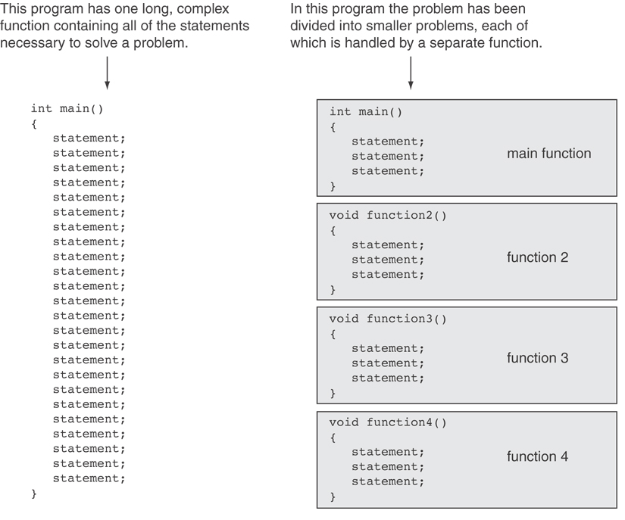
PAGE 3

Slide 4
Defining & Calling Functions
Function call: A statement that causes a function to execute.
Function definition: Statements that make up a function.
PAGE 4

Slide 5
Function Definition
Definition includes:
Name: Function names follow same rules as variables.
Parameter list: Variables containing values passed to the function.
Body: Statements that perform the function’s task, enclosed in {}.
Return type: Data type of the value that function returns to the part of the program that called it.
PAGE 5

Slide 6
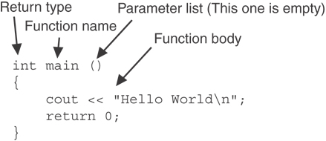
main() Function
Note: The line that reads int main() is the function header.
PAGE 6

Slide 7
Function Return Type
If a function returns a value, the type of the value must be indicated:
int main()
{
cout << “Hello World!\n";
return 0;
}
If a function does not return a value, its return type is void:
void main()
{
cout << “Hello World!\n";
}
PAGE 7

Slide 8
More info
[1] cplusplus.com: Functions
https://cplusplus.com/doc/tutorial/functions/
[2] learncpp.com: 2.1 – Introduction to Functions
https://www.learncpp.com/cpp-tutorial/introduction-to- functions/
PAGE 8

